Slide 1
Cyclone and Frontal Structure and Evolution
A First Look
Winter 2025
ATMS 370

Slide 2
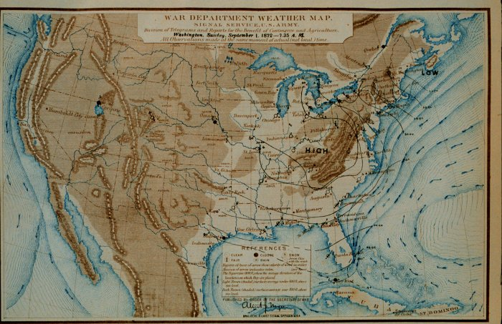
Early Surface Maps Had No Fronts
No real understanding of cyclones, fronts, and their evolution

Slide 3
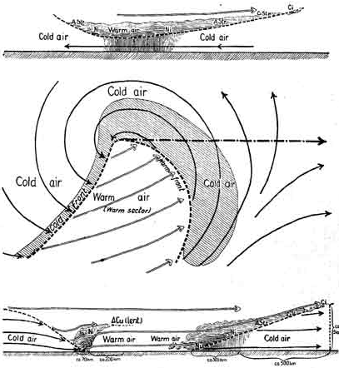
That all changed with the Norwegian Cyclone Model (Bergen School)
Bjernkes, 1919
Noted a direct
connection between
Low pressure center and fronts

Slide 4
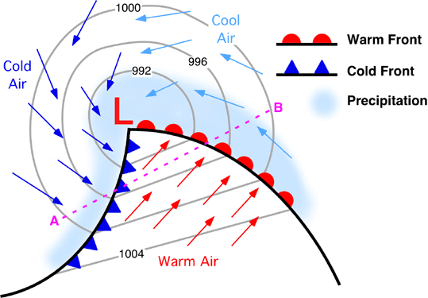
Modern Version
Midlatitude Cyclone And Fronts
Warm Sector

Slide 5
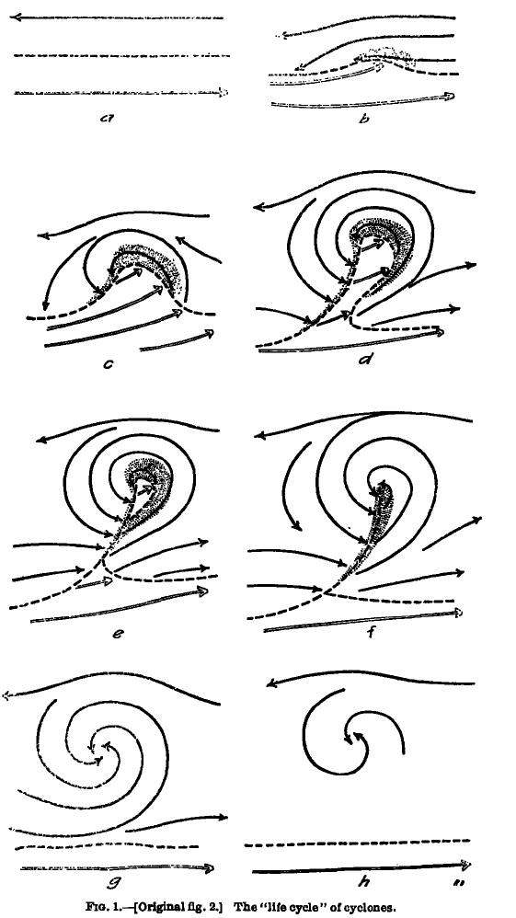
Concept of Evolution of Cyclones and Fronts
Bjerknes and Solberg
1922

Slide 6
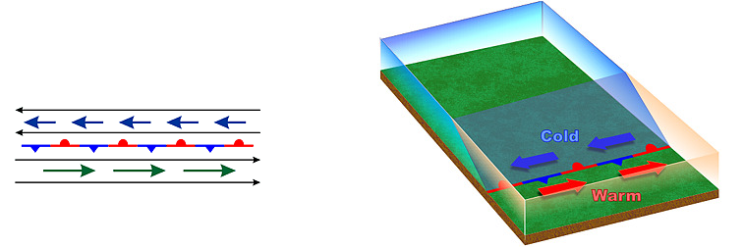
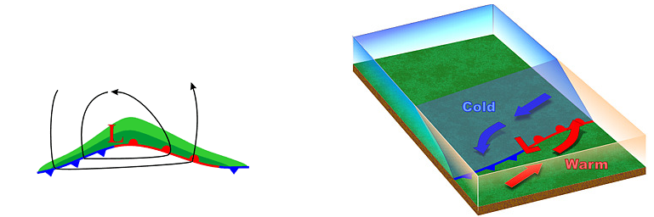
Stationary “Polar Front”
Wave Forming on Polar Front

Slide 7
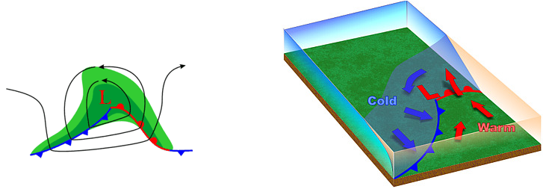
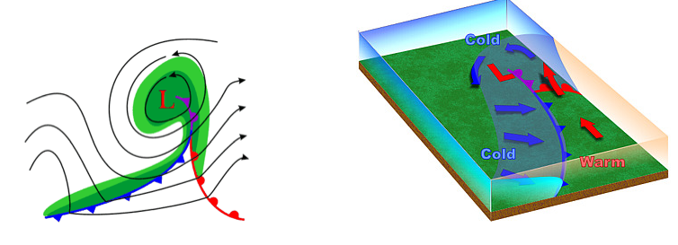
Wave Amplifies
Occluded Front Forms as Cold Front Catches Up to Warm Front
Triple
point

Slide 8
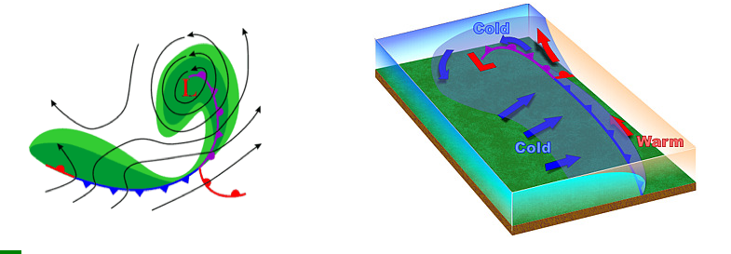
Occlusion Lengthens and System Weakens

Slide 9
As a surface front passes there are changes in:
Temperature (always at some level)
Dew point
Wind direction
Pressure
Cloudiness

Slide 10
Where is the front?
A
B
C
D
54
54
55
57
59
62
62
63
63

Slide 11
Refresher
A front is a boundary between relatively uniform warm air and a zone in which temperatures cools rapidly

Slide 12
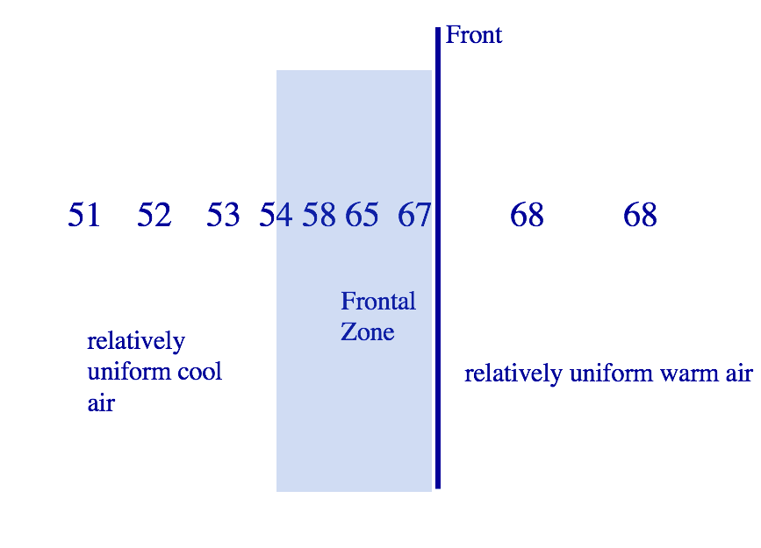

Slide 13
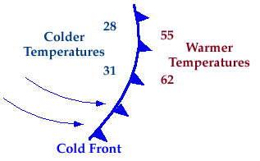
Four Main Types of Fronts
Frontal Zone is ALWAYS on the colder side
Frontal Zone

Slide 14
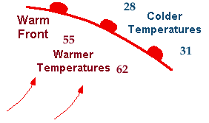
Warm Front

Slide 15
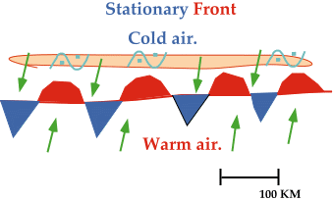
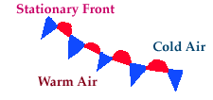
Stationary Fronts

Slide 16

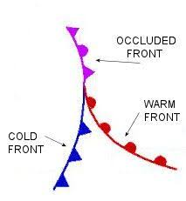
Occluded Front (a hybrid)

Slide 17
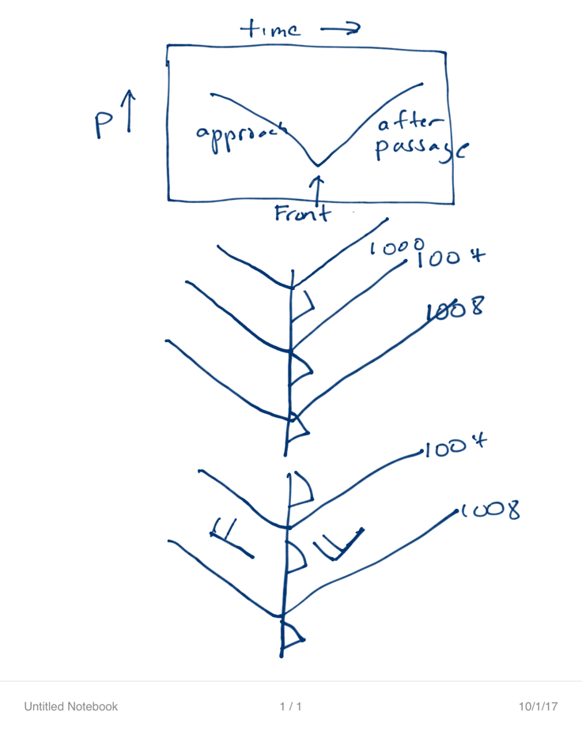
Fronts are usually associated with troughs of low pressure
L

Slide 18
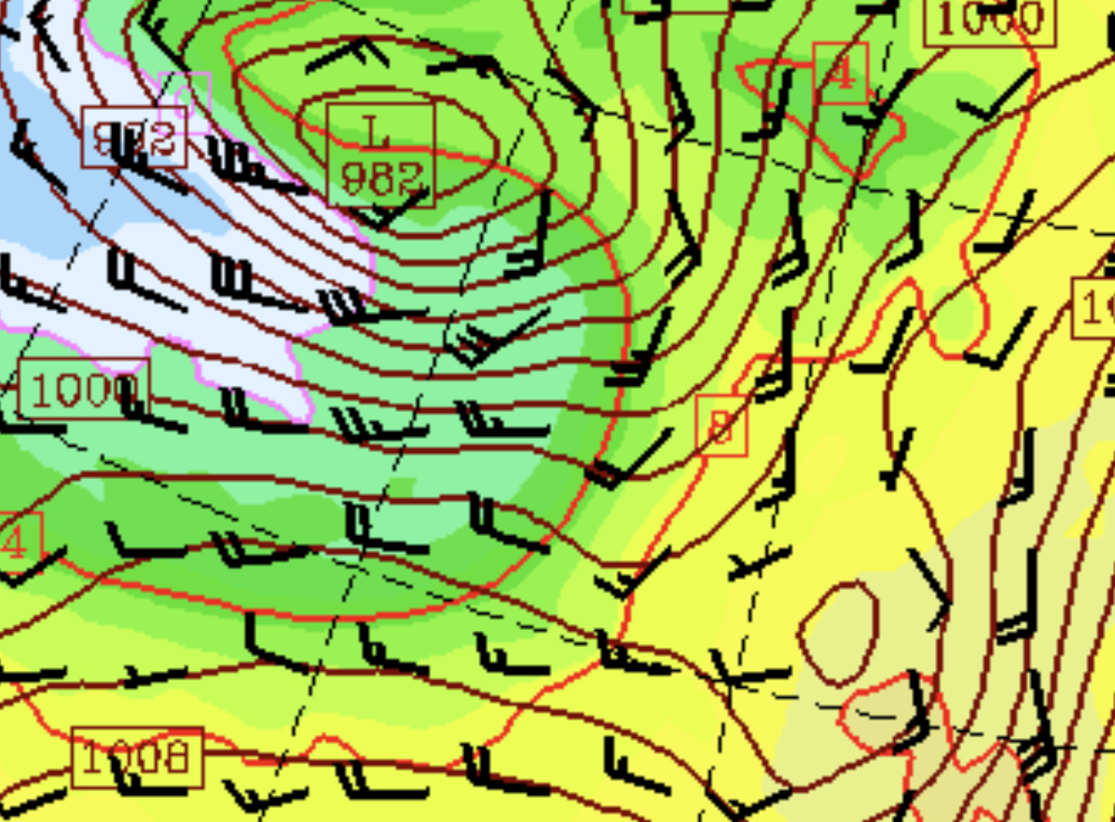
SLP, low level temp, winds

Slide 19
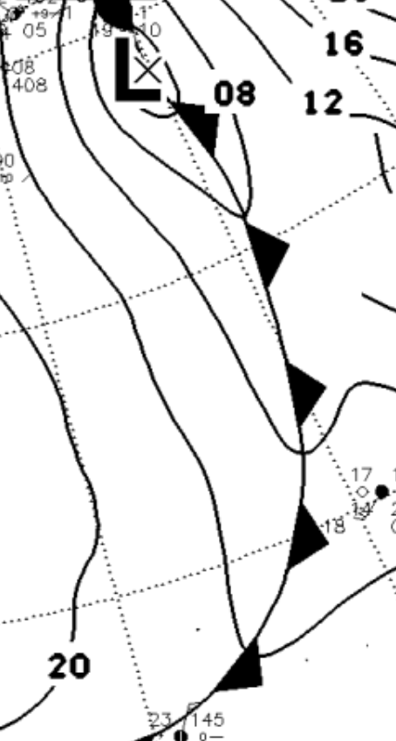
Decent Analysis

Slide 20
The trough is often evident in barograph traces

Slide 21
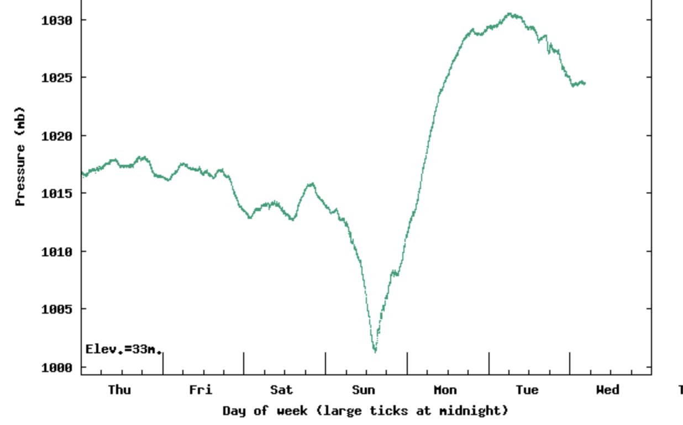

Slide 22
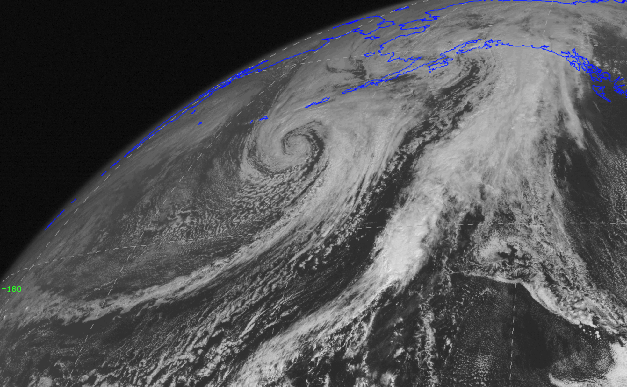
Fronts are associated with long bands of clouds

Slide 23
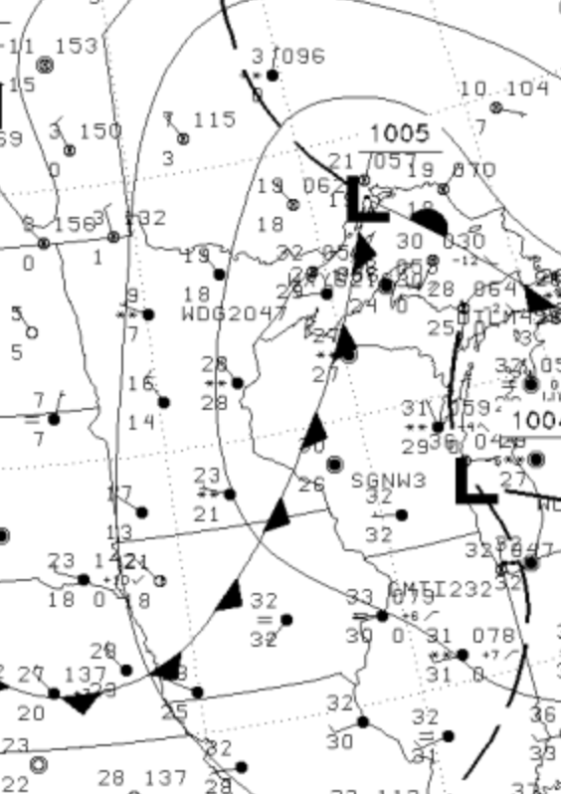
Dew point often falls behind fronts
The cold air behind fronts generally has less water vapor
Sometimes dew point is better than temperatures (more later)

Slide 24
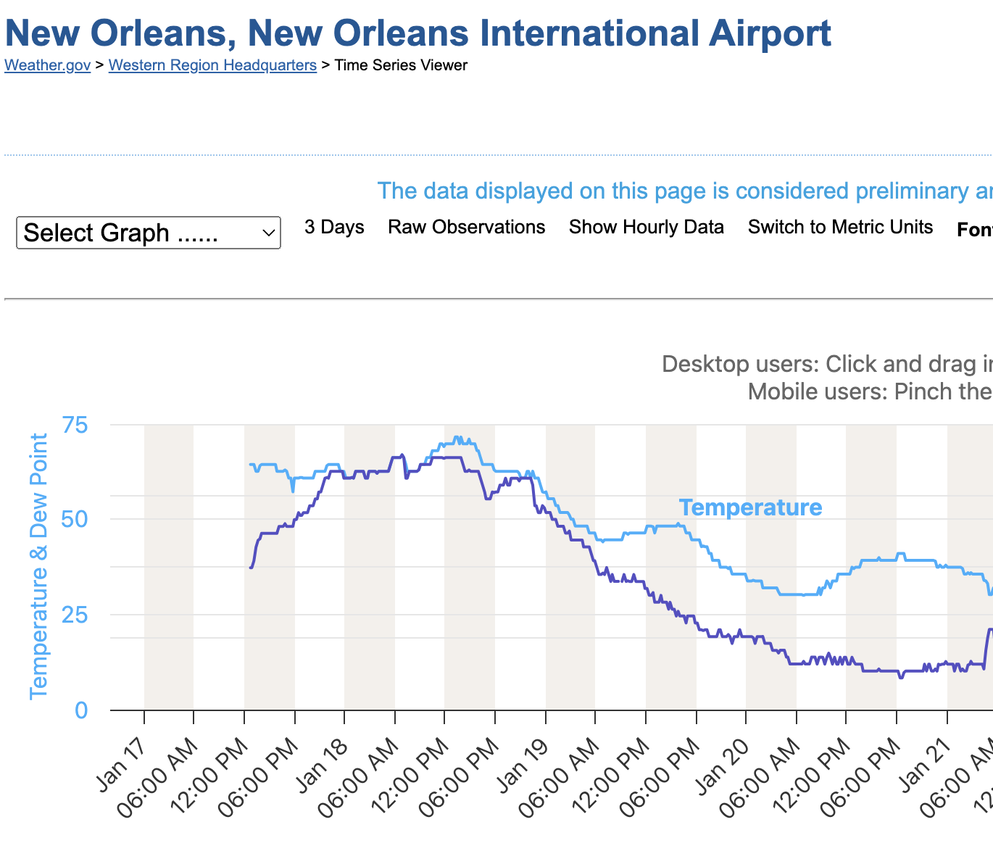

Slide 25
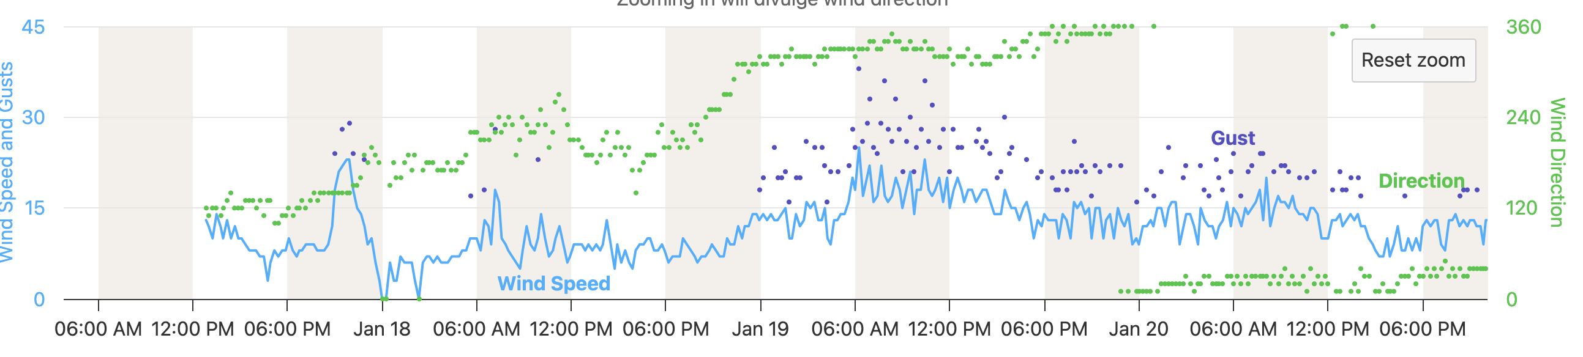

Slide 26
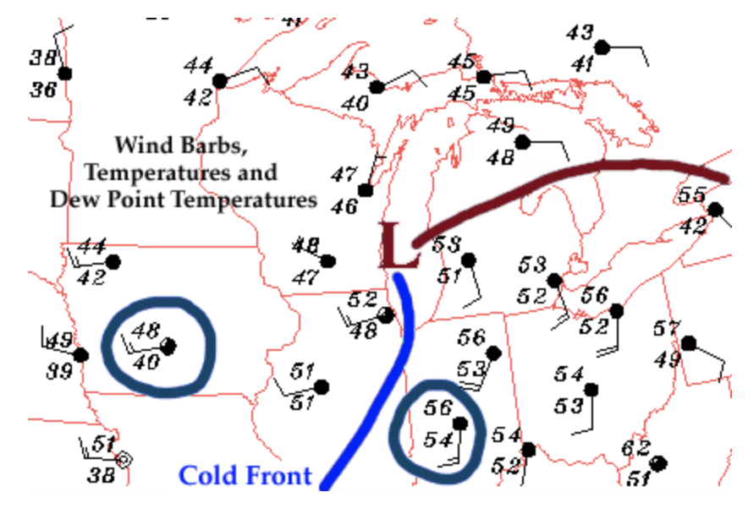

Slide 27
There is generally a wind shift/change of direction in the frontal zone (clockwise turning over time)

Slide 29
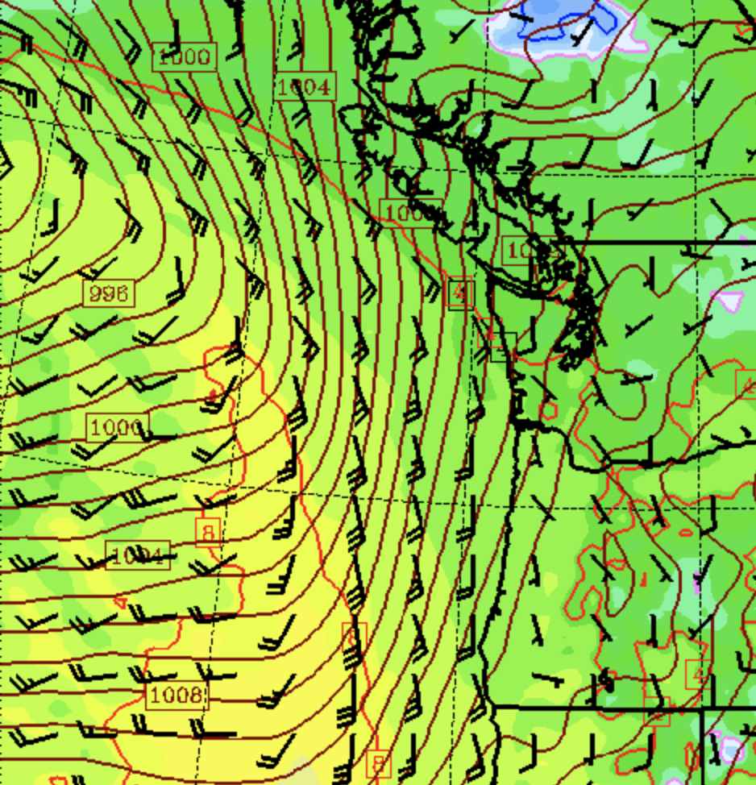

Slide 30
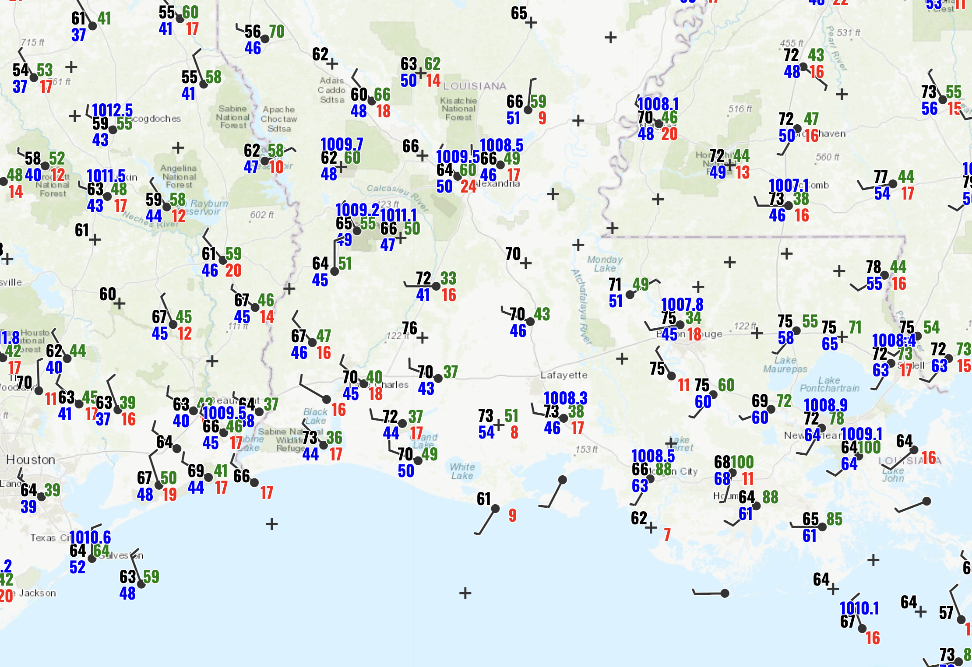

Slide 31
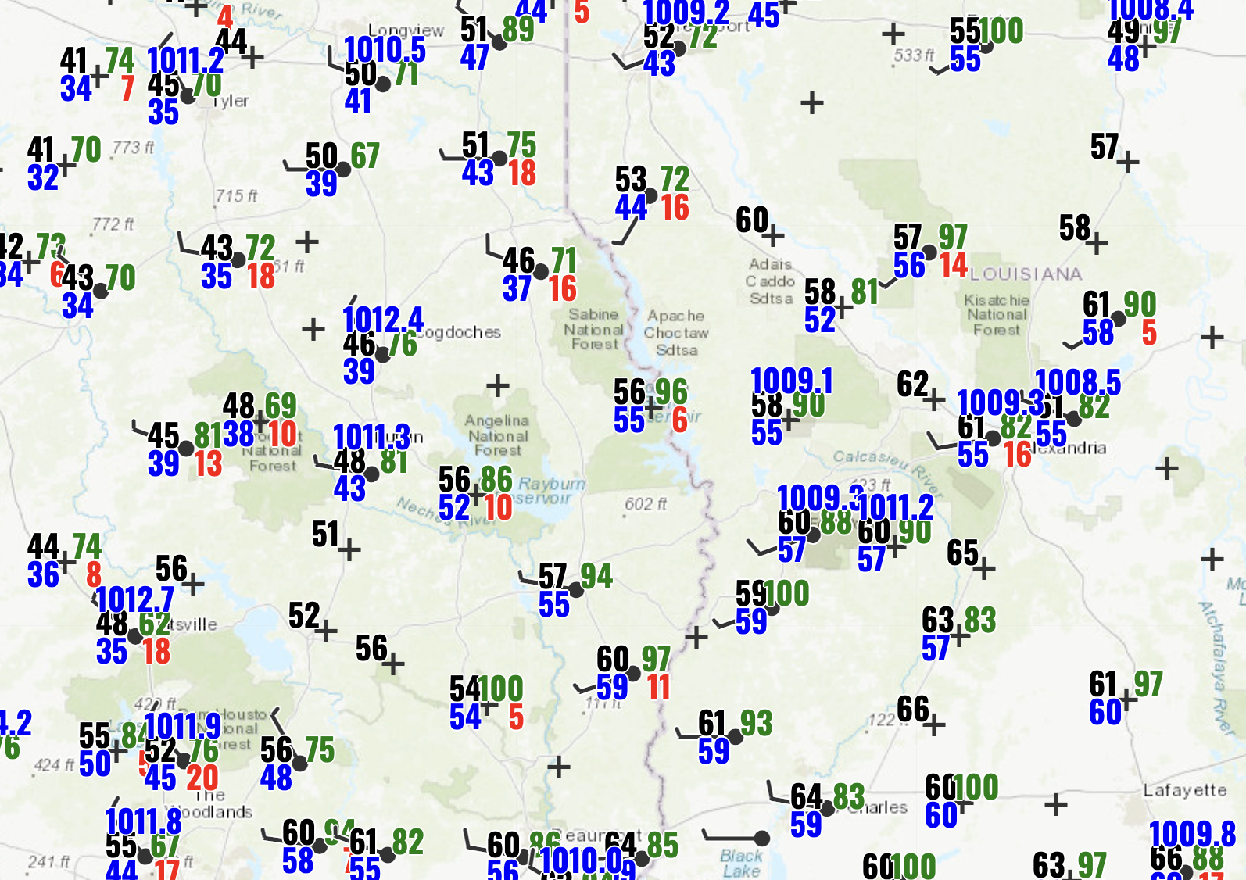

Slide 32
Vertical Structure of Fronts
You can’t understand the cloud and precipitation fields without understanding the 3-D air circulation with fronts and cyclones

Slide 33
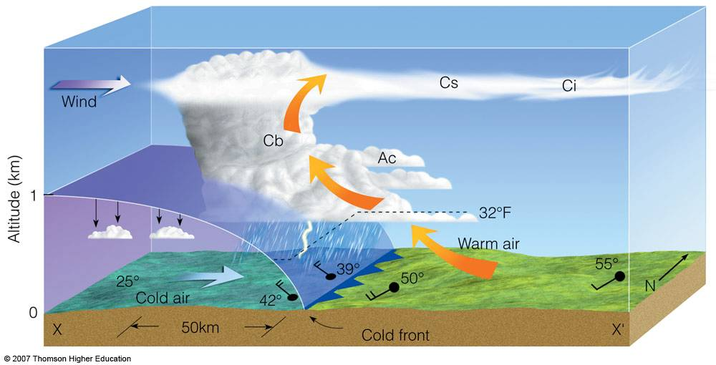
Cold Front
Slope~1:50 (steep), moves fast (20-30 mph), convection often on leading edge

Slide 34
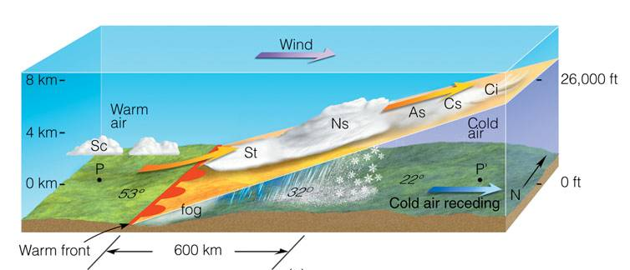
Warm Front
Lesser slope (1:200), slower (1—15 knots), more stratiform clouds

Slide 35
Stationary Front: similar structure to warm front, but without movement

Slide 36
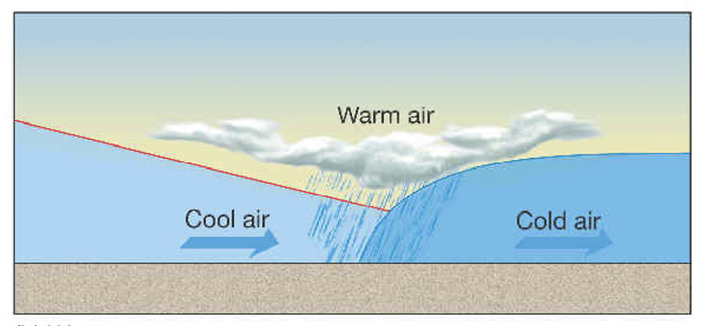
Occluded Front (More Later!)

Slide 37
There is a typical progression of clouds as cold and warm fronts approach and pass by
Cirrus
Cirrostratus
Altostratus
Nimbostratus
Cumulus after cold front
High, Middle, Low, Unstable/multi-level

Slide 38
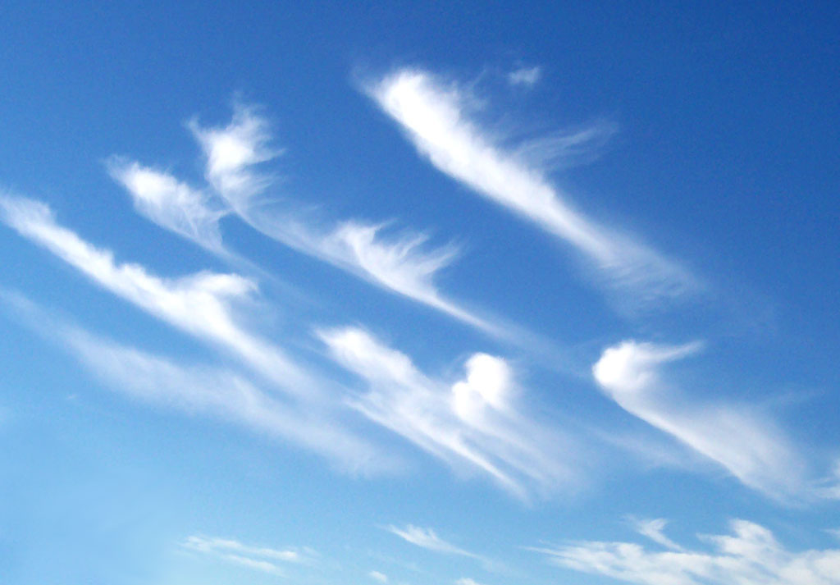
cirrus

Slide 39
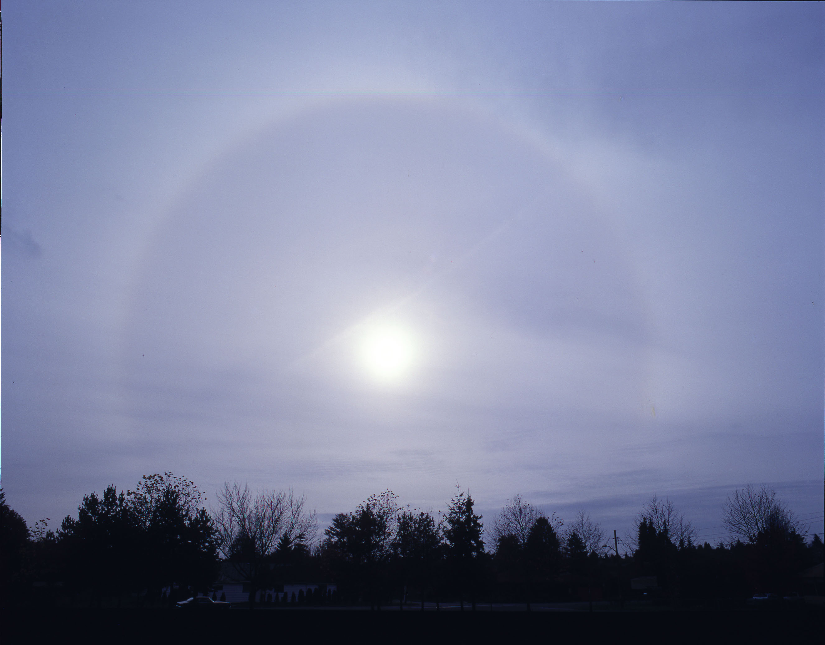
cirrostratus

Slide 40
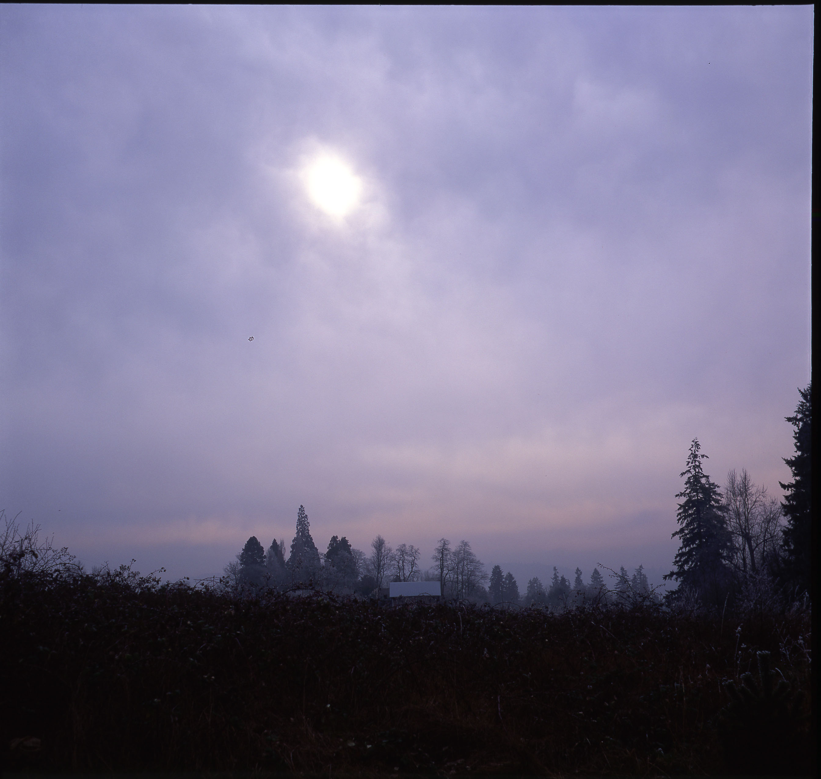
altostratus

Slide 41
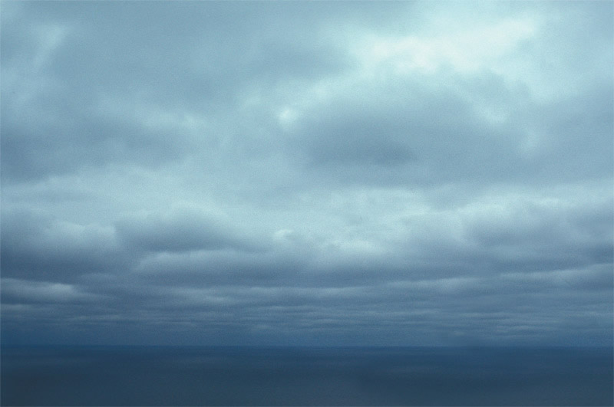
stratocumulus

Slide 42
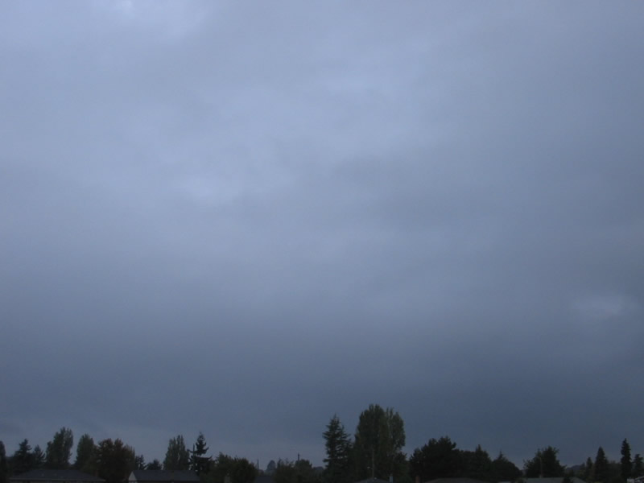
nimbostratus
Surface front is here!

Slide 43
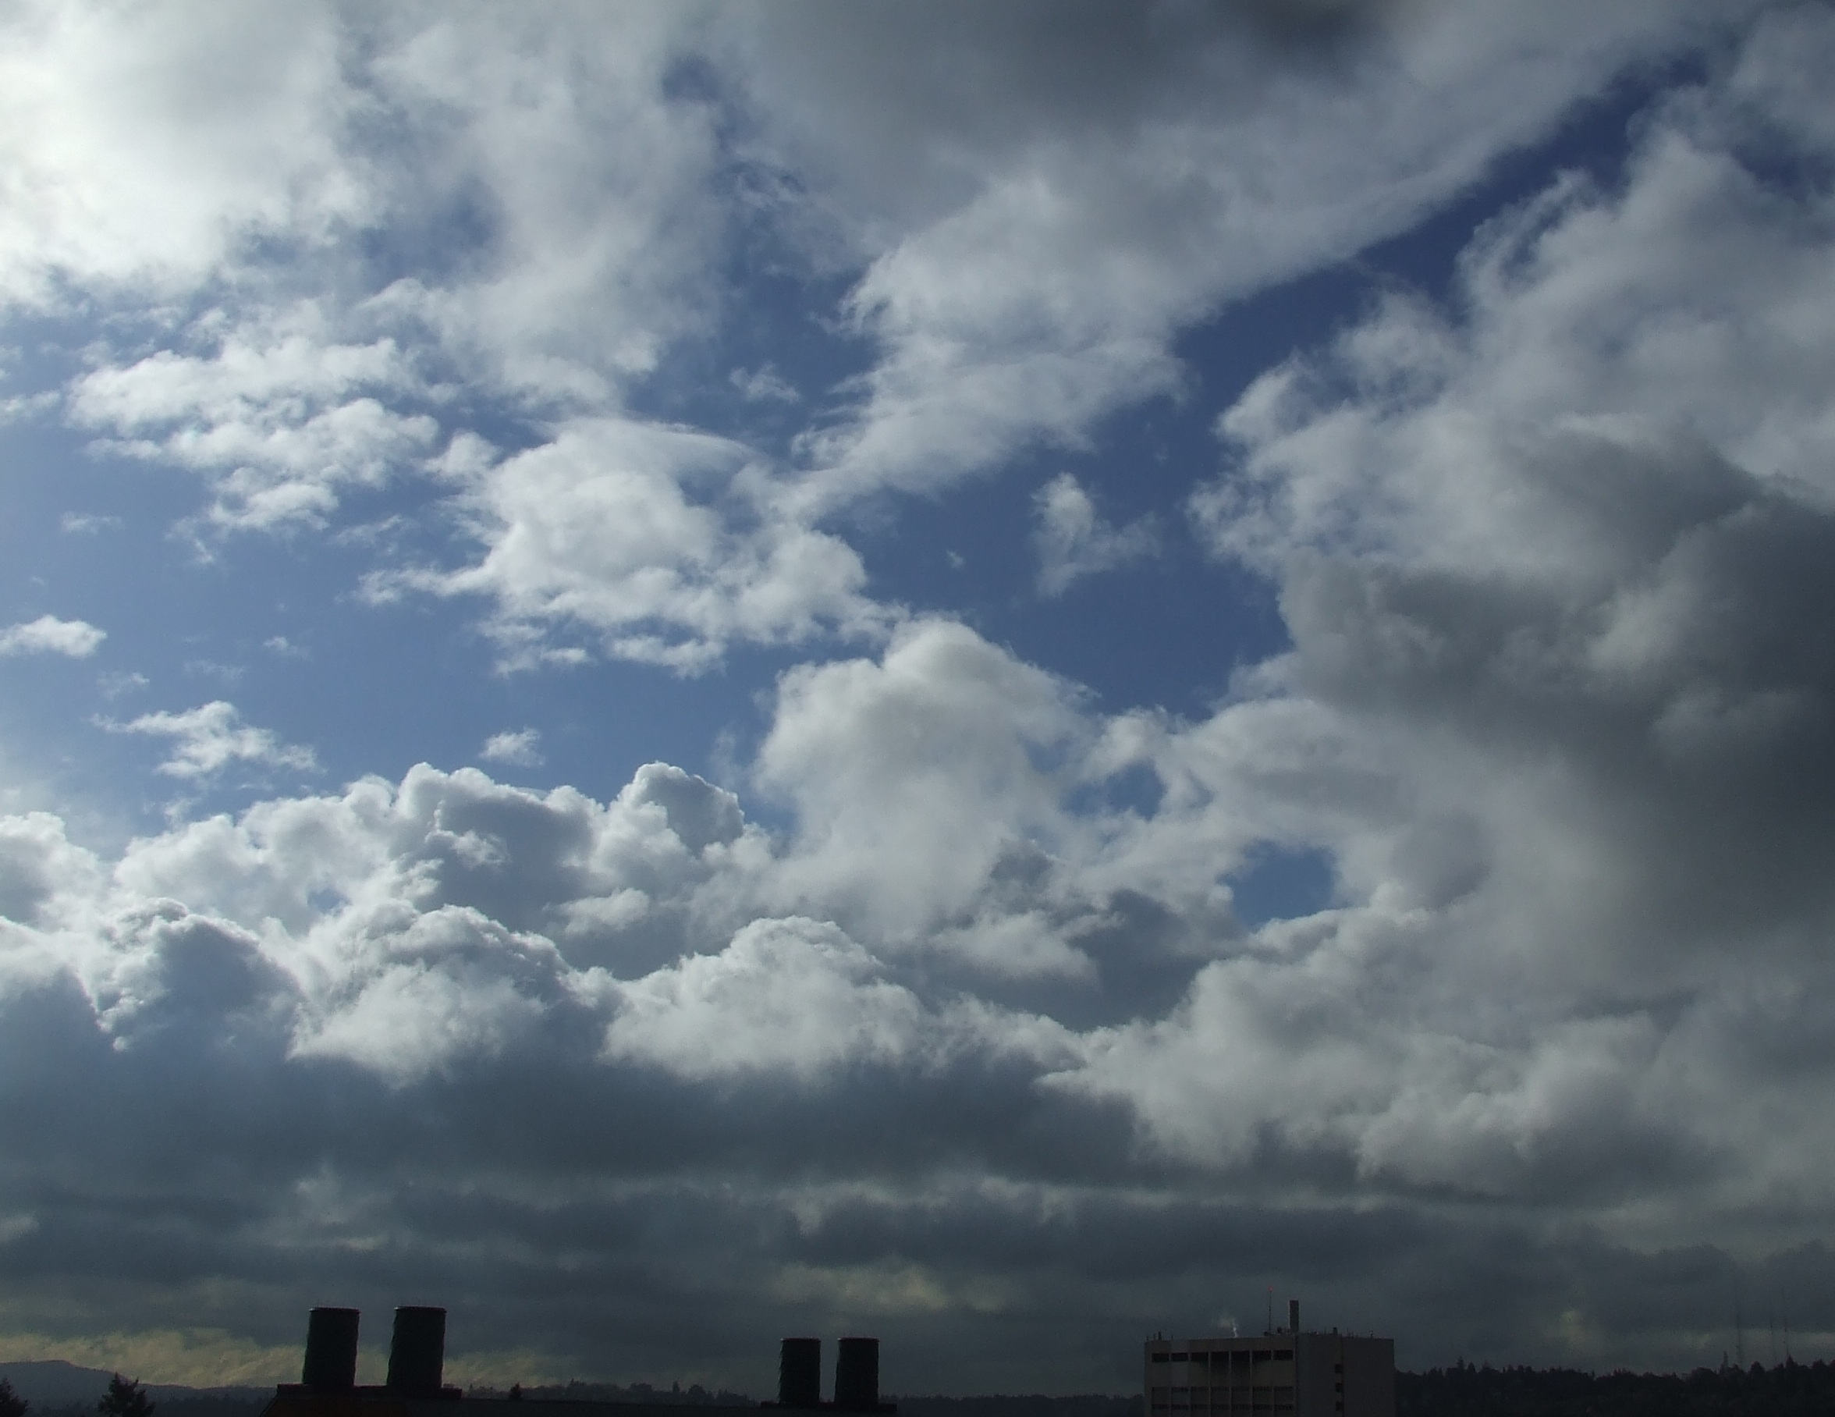
Cumulus, post frontal

Slide 44
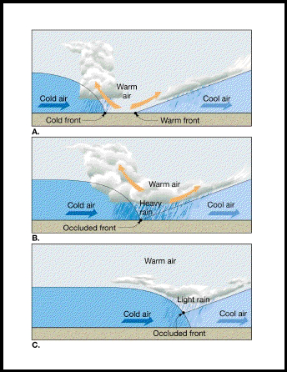
The Occlusion Process

Slide 45
In the occlusion process, the cold front moves faster than the warm front, catches up to the warm front, and joins with the warm front to create an occluded front

Slide 46
Stationary Polar Front
Wave Forming on Polar Front

Slide 47
Wave Amplifies
Occlusion as Cold Front Catches Up to Warm Front

Slide 48
Occlusion Lengthens and System Weakens

Slide 49
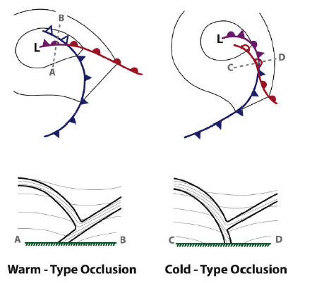
The Norwegians suggested there were both warm and cold occluded fronts depending on which side had the coldest air
cool
coldest
coldest
cool

Slide 50
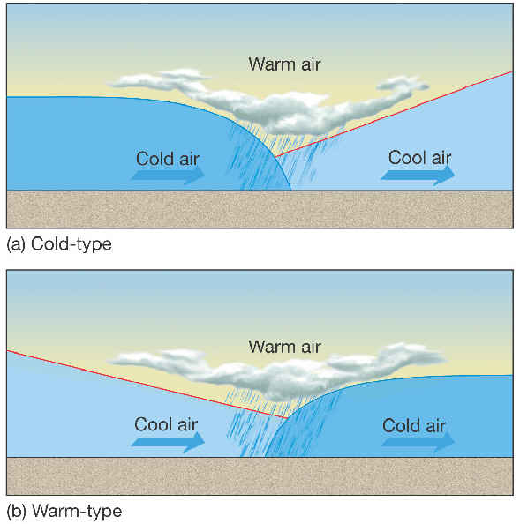
Warm and cold occlusions
Cold
Occlusion if
air behind is colder
Warm
occlusion
air if air in front
Is colder

Slide 51
Cold-Type Occlusions are Not Observed
X
cool
coldest
coldest
cool

Slide 52
In the real world, only the warm occlusion is observed

Slide 53
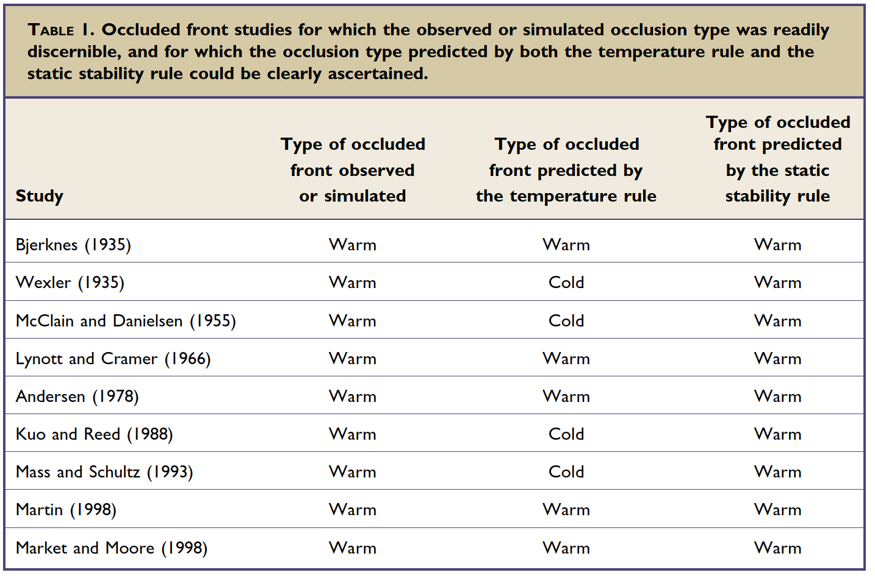
Only Warm Occlusions Observed
From Stoelinga et al 2002, BAMS

Slide 54
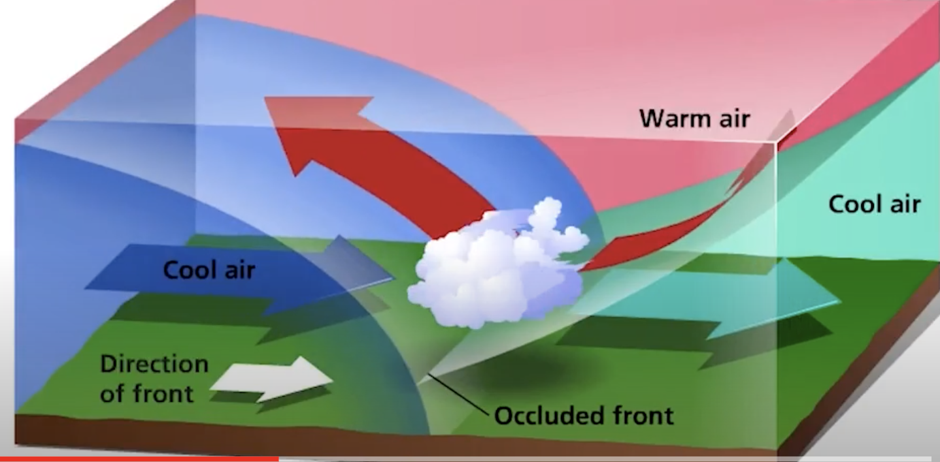
What controls the slope and structure of occluded front?

Slide 55
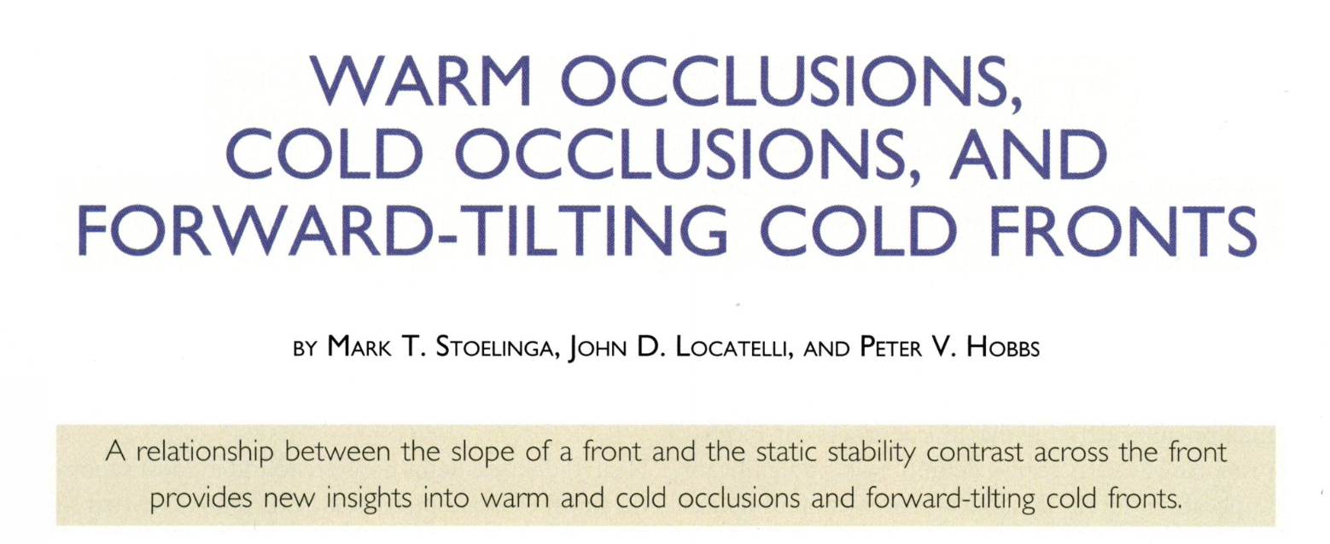
The Explanation Why

Slide 56
The Static Stability Rule of Occluded Front Slope
An occluded front slopes over the statically more stable air, not the colder air.
Stoelinga et al., 2002

Slide 57
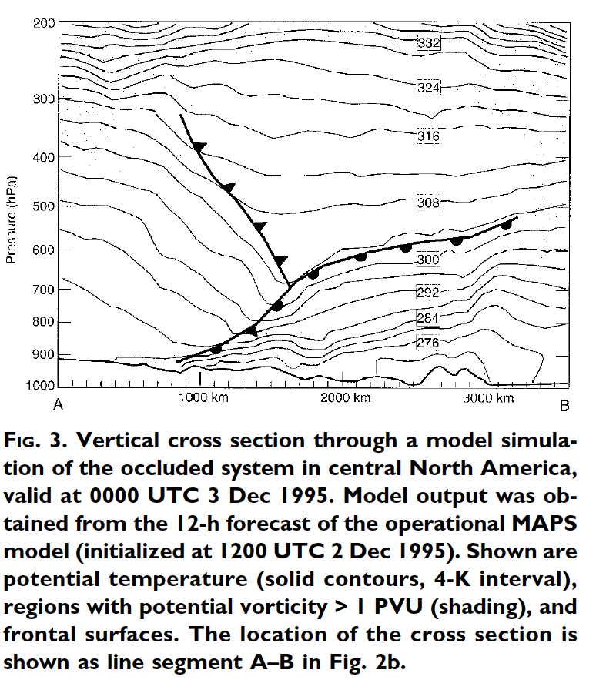
An Example
Less
Stable
More Stable

Slide 58
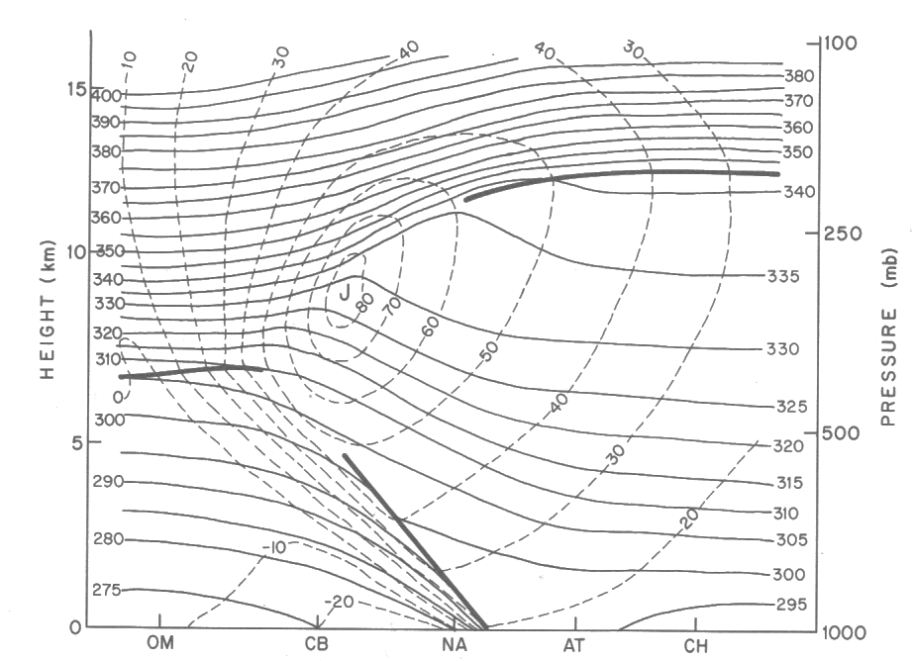
Remember we can evaluate vertical stability looking at the vertical gradient of potential temperature
stable
Less stable
POTENTIAL TEMPERATURE

Slide 59
Generally, statically stable air is in advance of weather systems, so we generally observe warm occlusions
Less stable
More stable

Slide 60
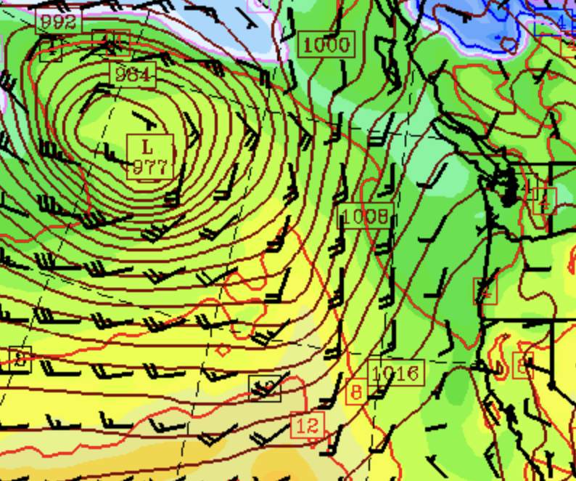
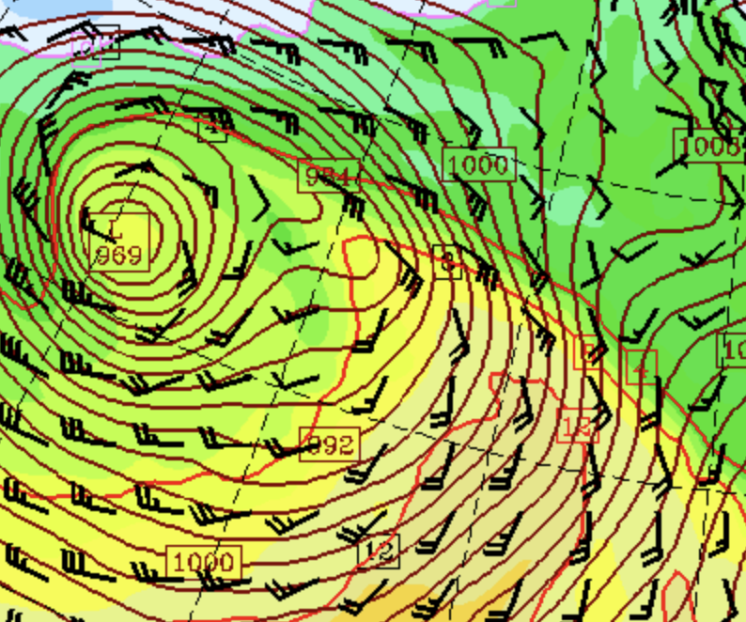
At low levels, the thermal structure of occlusions is characterized by a tongue of warm air associated with the occluded front

Slide 61
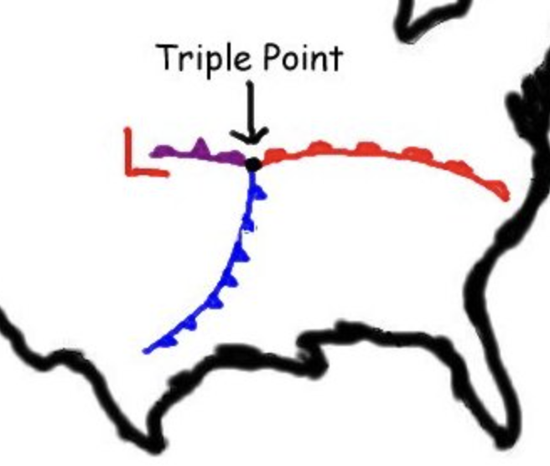
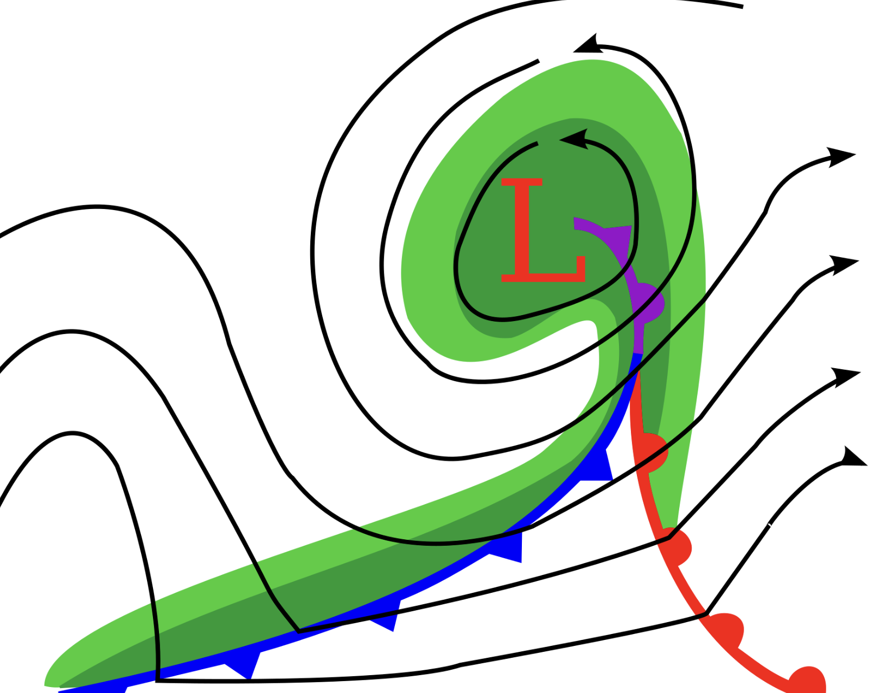
Terminology: The Triple Point

Slide 62
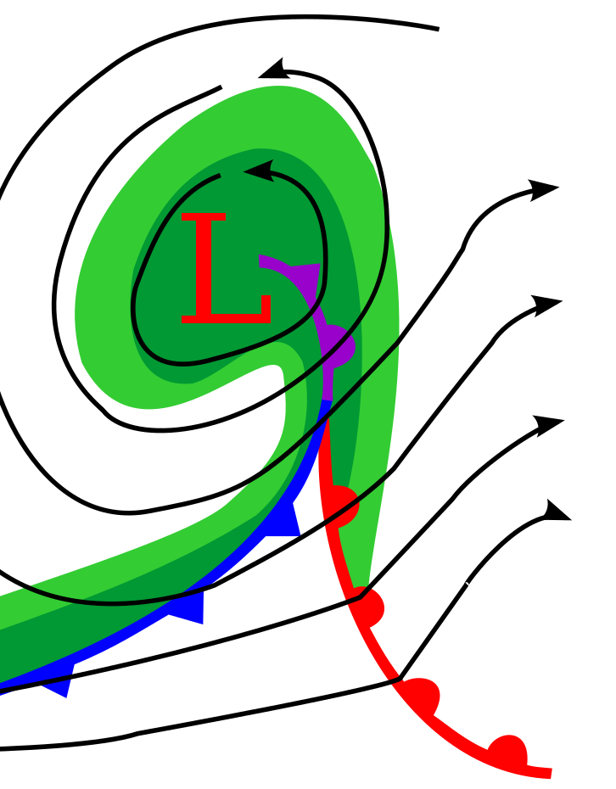
According to the Norwegian Cyclone Model Cyclones Begin to Weaken When They Start to Occlude
In reality, cyclones continue to deepen for many hours after the formation of the occluded front.
Example: 29 of the 91 northeast United States cyclones deepen 8–24 mb during the 12–24 h after formation of the occluded front (Kocin and Uccellini, 2004)

Slide 63
Is Frontal Catch-Up an Essential Part of Occluded Front Development?
Not all occluded fronts developed from cold fronts overtaking warming fronts.
Far more fundamental is the distortion of warm and cold air by circulations around low centers/cyclones. More later on this.

Slide 64
The Norwegian Cyclone Model Is A Good Start but Reality Can Be Different
Low level structures can be altered over vast ocean areas
Terrain can distort, alter, and destroy frontal structures.
More on all of this later.

